Slide 1
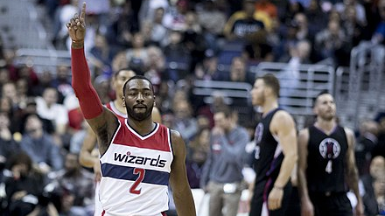
NBA analysis dashboard
William Reinhold
This Photo by Unknown Author is licensed under CC BY-SA

Slide 2
Background
Aimed to show how NBA teams are built
Can be used to compare various statistics
Broken down at the position and team level

Slide 3
Ethical Considerations
NBA data is publicly available.
This data set was downloaded from Kaggle.com, a website for data scientists and others to share large data sets.
Data only included stats that can be scraped for free from the NBA website.

Slide 4
React, Recharts, & MUI
React is a library that allows you to create components that are reusable pieces of code like buttons, videos, and graphs that you can use to build interfaces.
Recharts is a way to use Reacts library to build out graphs.
Material UI is a way to get fancy looking components like buttons, dropdown menus, and tables to use in your interface.

Slide 5
Data Cleaning & Storage
The CSVs were imported into a Python file for cleaning.
Dropped unnecessary columns, formatted columns, etc.
Data was exported into JSONs and added into MongoDB to be stored.

Slide 6
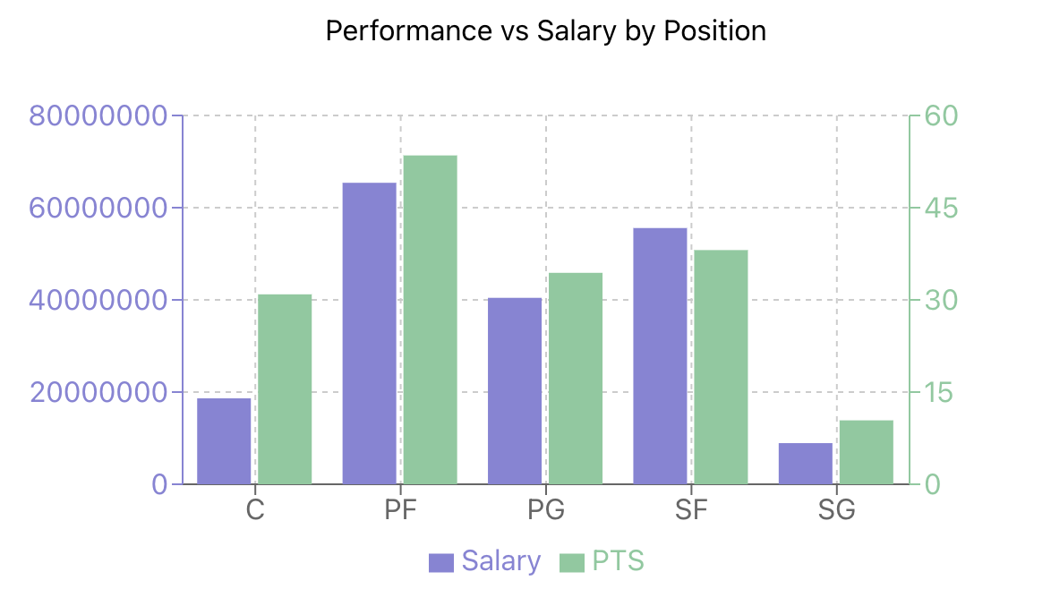
First Graph

Slide 7
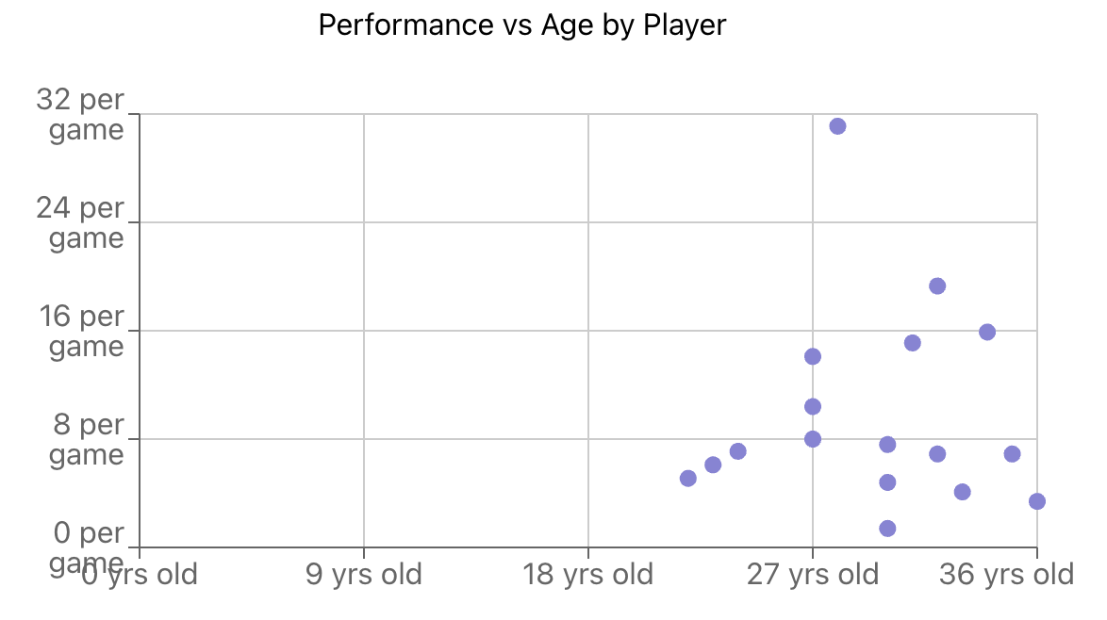
Second graph

Slide 8
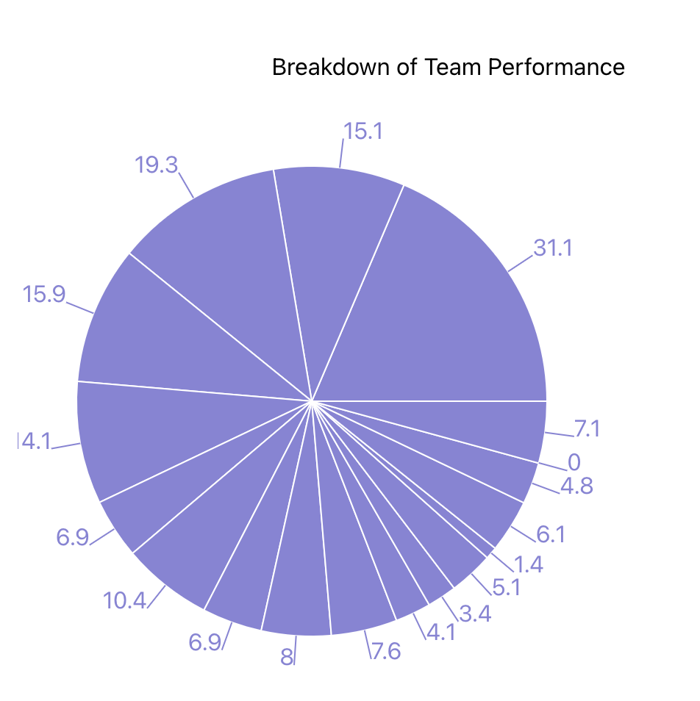
Third Graph

Slide 9
References
Project can be found at https://github.com/wreinhold/nba-analysis-project.
Data is sourced from https://www.kaggle.com/datasets/jamiewelsh2/nba-player-salaries-2022-23-season.
The following websites were used as guides
vitejs.dev
react.dev
recharts.org
mui.com

